Slide 1
Propagation Graph Neural Networks lecture-14 Course on Graph Neural Networks (Winter Term 20/21)
Christian Medeiros Adriano (christian.adriano@hpi.de) - “Chris”
Sona Ghahremani (sona.ghahremani@hpi.de )
Prof. Dr. Holger Giese (holger.giese@hpi.de)

Slide 2
Quick recap – Where are we now?
Intro and Course Organization
Graph Metrics and Random Models
Graph Structural Features – Clustering
Message Passing & Belief Propagation
Graph Embeddings - Message Passing
PageRank & Markov Chains
Graph Convolutional Networks
Graph Attention Networks
Graph Evolution Networks
Temporal Graph Networks
Graph Neural Differential Equations
Deep Graph Generative Models
Causal Graph Neural Networks
Propagation Graph Neural Networks
Network Effects, Cascading and Contagion
Outbreak Detection and Influence Maximization
Design concerns
Understand a phenomenon
Extract features
Stablish baselines
Preprocessing data
Description models
Predict an outcome
ML architecture and pipeline
Training models
Evaluation models
Prediction models
Effects of interventions
Risks of confounding
Causal structure
Intervention models

Slide 3
Topics (to be done)
Network Cascades Phenomena
Decision-Based Models (Technology adoption)
Probabilistic Models (Contagion)
Greedy and Sketch approaches
Influence maximization and Submodularity
Outbreak detection and intervention
Minimize time to detection and
Minimize the number of affected nodes
Maximize the number of detected outbreaks
Outlook
Feedback-Control of Dynamical Network Systems
Identifiability, Observability, Stability, Sensitivity
Methods for High Scale Network Systems
Scalability, Sparsity, Reliability
Quantum Programming with Applications to Machine Learning
Notes:
Dimensionality reduction (Control Theory, Dimensionality Reduction, Latent-Variable Models)
Discrete Optimization, Randomization, Exploration/Exploitation, Immutable Architectures, Microservices

Slide 4
Decision-Based Cascading Models

Slide 5
Propagation as Decision Making
Each person can adopt technology that maximizes its utility.
The benefit is based on how many of the neighbors adopted the same technology in t-1
For instance, if a node obtains a utility of “a” if the node adopts the technology A shared with a neighbor node.
Example: Technology adoption options are A, B, or AB. In the case of adopting AB, there is a cost “c”. Assuming that every node start with B, below is a possible intermediate state.
utility
-c
cost
-c
A
a
A
a
AB
max(a,b)
AB
b
B
How will the adoption of technology cascade through the network?
Will it cascade indefinitely, or will it stop at some point?
How do the individual costs of each pay-off affect the cascades?

Slide 6
Example
Path graph: start with B. and A is better than B, because a>b
What happens when one node switches to A?
With A, B, AB, Does A spread?
a=3
A
a=3
A
0
B
b=2
B
b=2
B
c=-1
-c
A
a=3
A
a=3
AB
b=2
AB
b=2
B
Hardwired to adopt A

Slide 7
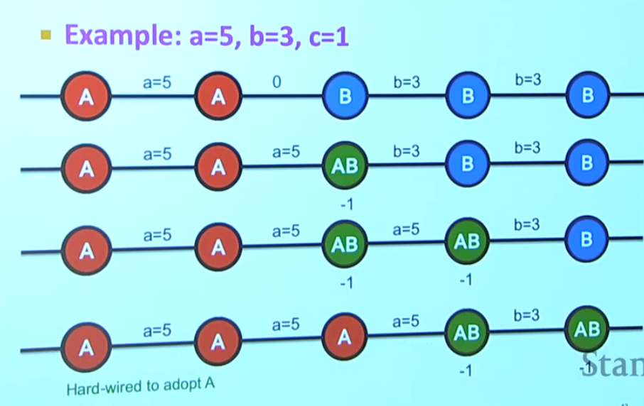
a=5
A
A=5
A
0
B
b=3
B
b=3
B
a=5
A
A=5
A
A=5
AB
b=3
B
b=3
B

Slide 8
Generalized Decision Model
Given payoffs: Fp(A) = a, Fp(B) =1, Fp(AB) = a+1-c
When X will choose A, B, AB?
A
X
B
B vs A
a=1, c>1 → AB ϵ[-∞,1], B=1, A=1
a=1, c<1 → AB ϵ[1,2], B=1, A=1
AB vs B
a=c<1 → AB=1, B=1, A<1
a=c>1 → AB=1, B=1, A>1
Cost c
A
B
A
c=1
AB vs A
c=1, a<1 → AB=A<1, B=1, A<1
c=1, a>1 → AB=A>1, B=1, A>1
B
AB
AB
a=1
Payoff a
a=c=1 → AB=B=A=1
sources: Lecture 12 Network Effects and Cascading Behavior, Stanford CS224W, Jures Leskovec
Notes:
] Eisenberg, Joseph. "R0

Slide 9
Generalized Decision Model
Given payoffs: Fp(A) = a, Fp(B) =2, Fp(AB) = a+1-c
When X will choose A, B, AB?
AB
X
B
B vs A
a=2, c>1 → AB ϵ[-∞,2], B=2, A=2
a=2, c<1 → AB ϵ[2,3], B=2, A=2
AB vs B
c=a-1,c<1 → AB=2, B=2, A ϵ [1,2]
c=a-1,c>1 → AB=2, B=2, A > 2
Cost c
A
B
A
c=1
AB vs A
c=1, a<2 → AB=A<2, B=2, A<2
c=1, a>2 → AB=A>2, B=2, A>2
B
AB
AB
1
2
Payoff a
a=2,c=1 → AB=B=A=2
sources: Lecture 12 Network Effects and Cascading Behavior, Stanford CS224W, Jures Leskovec
Notes:
] Eisenberg, Joseph. "R0

Slide 10
Probabilistic Cascading Models

Slide 11
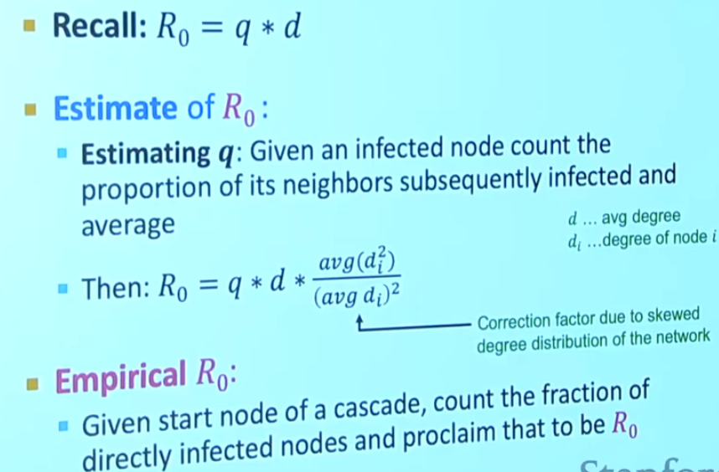
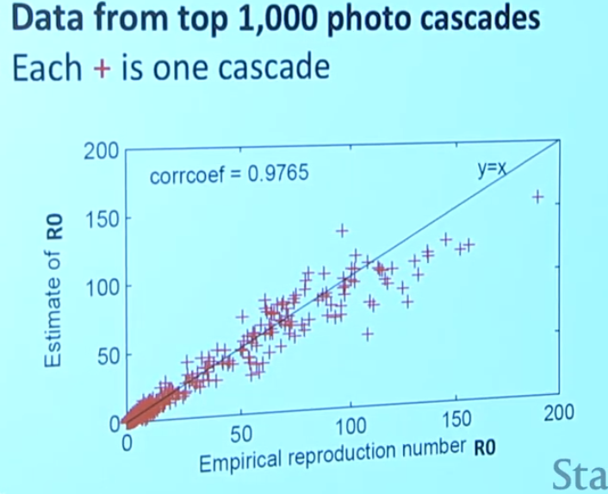
Notes:
Beginning already gives a good estimate of the Ro, but we also see where it does not work well, for the super popular,
Reproductive number is non-stationary, because as more people get infected it gets more difficult to find other infected ones.
So, it has a concave shape, fast growth, plateaus, then decays.

Slide 12
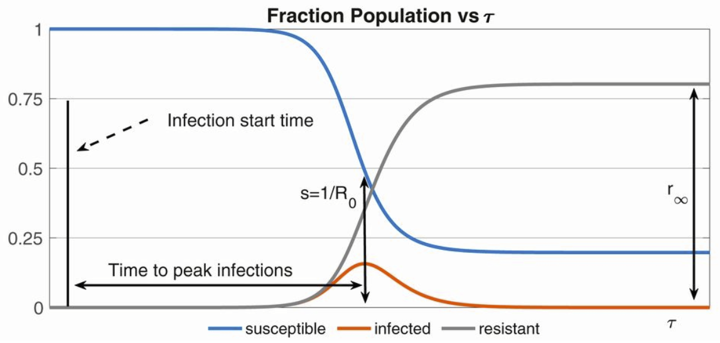
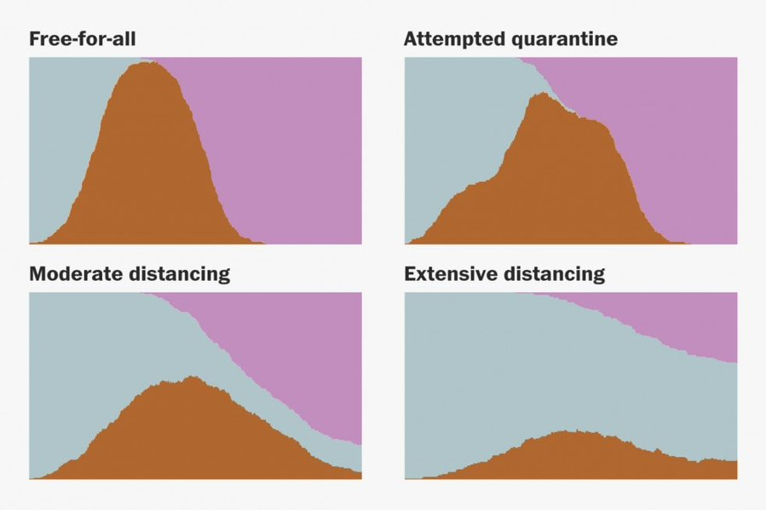
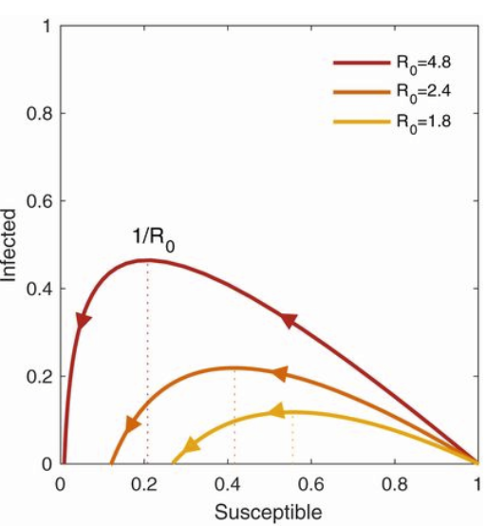
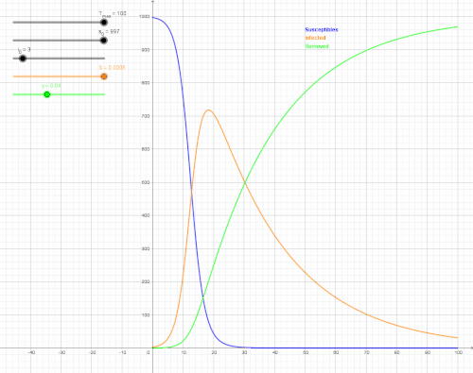
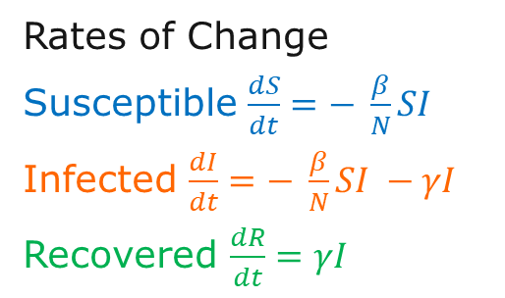
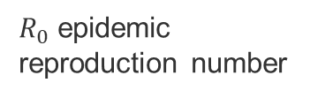
SIR model
α alpha
μ*
[Bertozzi 2020]
Susceptible
βI
Infected
γ
Recovered
μ
μ
μ
μ* birth rate
μ mortality rate
I infection rate
γ recovery rate
α reinfection rate
[Stevens 2020]: https://twitter.com/Harry_Stevens/status/1238940084994523136
S
I
R
$R_{0}$epidemic reproduction number
[Bertozzi 2020]
[Eisensberg 2020]
Rates of Change
Susceptible $\frac{dS}{dt}=− \frac{β}{N}SI$
Infected $\frac{dI}{dt}=− \frac{β}{N}SI −γI$
Recovered $\frac{dR}{dt}=γI$
[Wikipedia 2020]
Notes:
If alpha = zero, then we have lifelong immunity
[Wikipedia 2020] https://en.wikipedia.org/wiki/Compartmental_models_in_epidemiology#The_SIR_model
[Eisenberg 2020] Eisenberg, Joseph. "R0: How scientists quantify the intensity of an outbreak like coronavirus and its pandemic potential." The Conversation, Michigan University School of Public Health 27 (2020). https://sph.umich.edu/pursuit/2020posts/how-scientists-quantify-outbreaks.html
[Bertozzi 2020] Bertozzi, Andrea L., et al. "The challenges of modeling and forecasting the spread of COVID-19." Proceedings of the National Academy of Sciences 117.29 (2020): 16732-16738.
[Stevens 2020] Why outbreaks like coronavirus spread exponentially and how to "flatten the curve"
https://twitter.com/Harry_Stevens/status/1238940084994523136

Slide 13
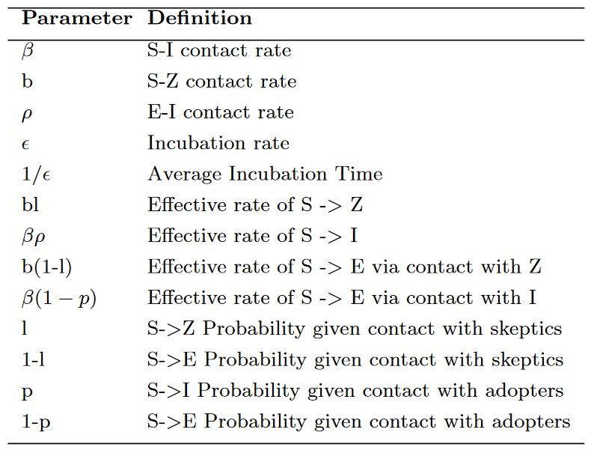
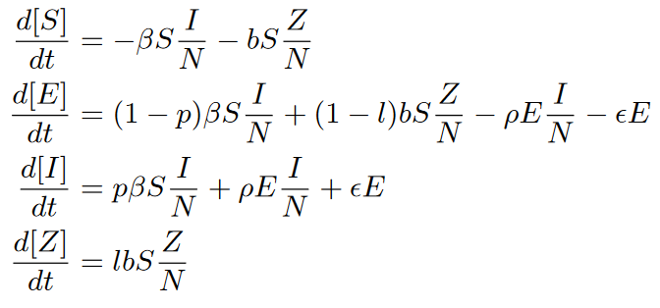
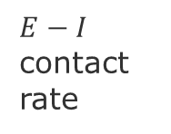
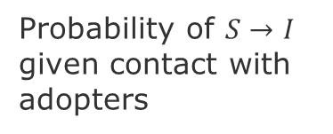
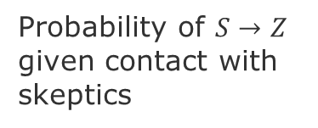
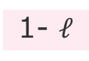
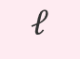
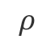
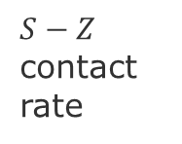
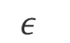
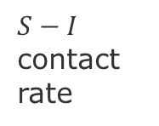
SEIZ model
S susceptible, E exposed, I infection rate, Z skeptics
Probability of $S→I$ given contact with adopters
α alpha
$S−I$ contact rate
Infected
p
$$ε$$
Susceptible
β
$$ρ$$
1-p
Exposed
$E−I$ contact rate
$S−Z$ contact rate
b
1- $ℓ$
Skeptic
N = population size
Probability of $S→Z$ given contact with skeptics
$$ℓ$$
Notes:
Jin, et al. 2013, Epidemiological Modeling of News and Rumors on Twitter
Vosoughi, S., Roy, D., & Aral, S. (2018). The spread of true and false news online. Science, 359(6380), 1146-1151.

Slide 14
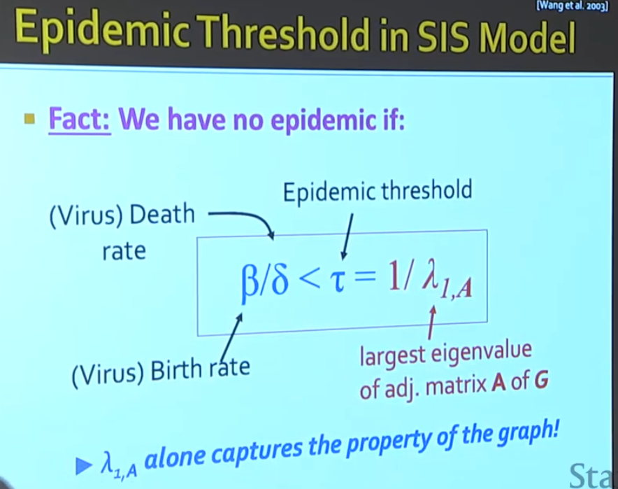
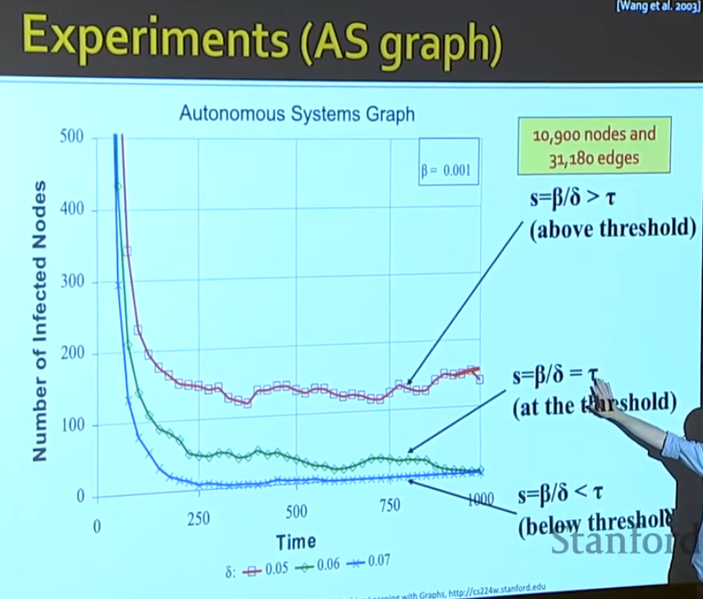
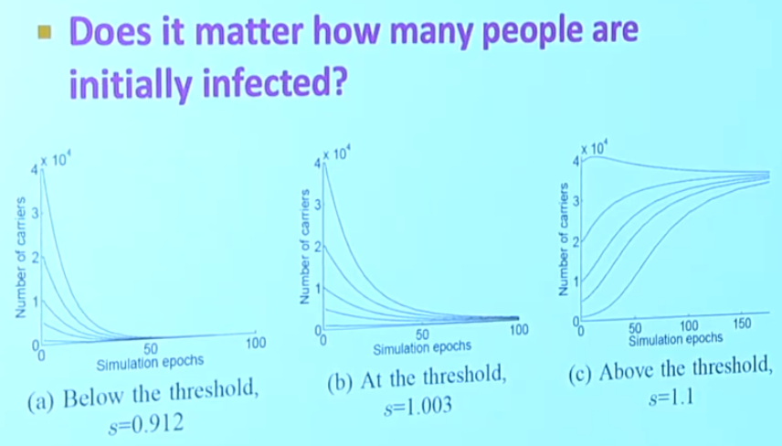
SIS model

Slide 15
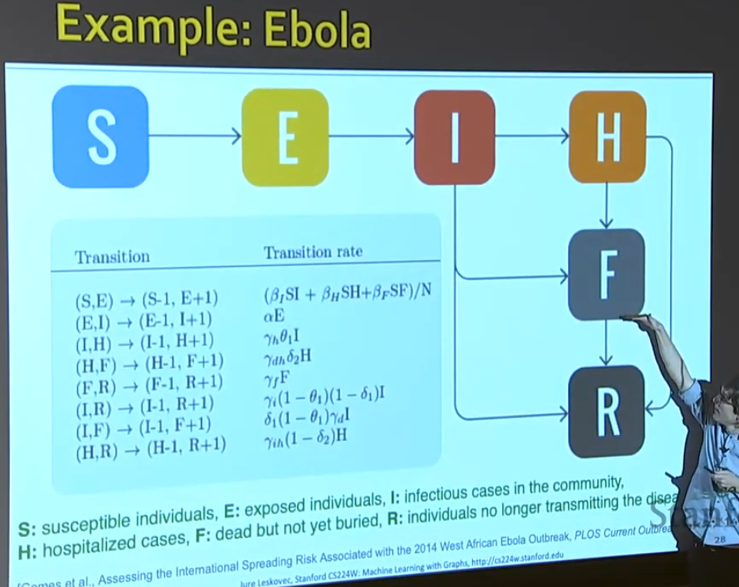
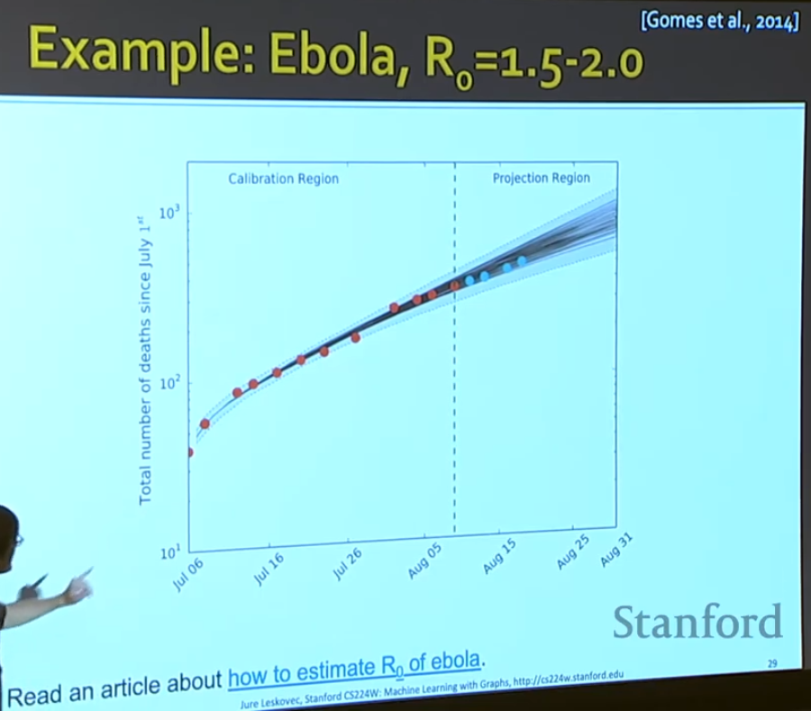

Slide 16
Independent Cascade model [Kempel, Kleinber, Tardos 2003]
D. Kempe, J. Kleinberg, and ´ E. Tardos, (2003) “Maximizing the spread of influence through a social network,” ACM SIGKDD

Slide 17
Greedy approach

Slide 18
Sketch approach

Slide 19
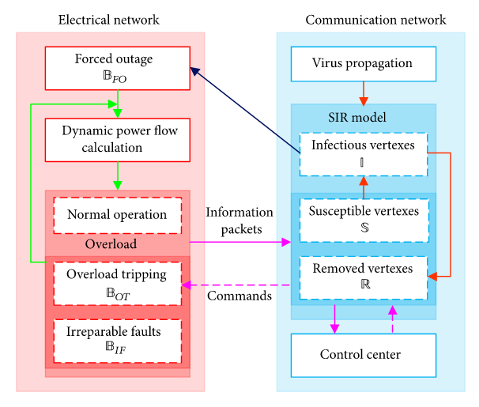
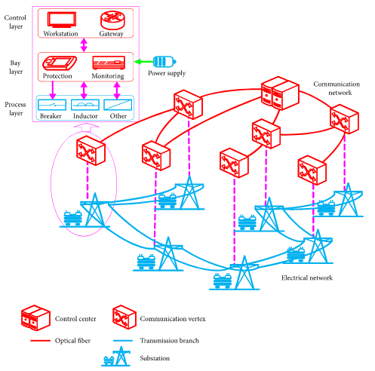
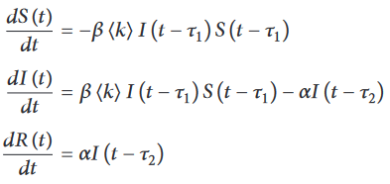
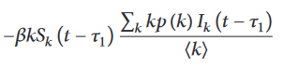
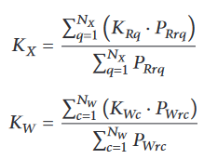
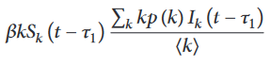
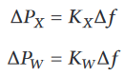
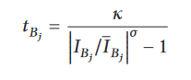
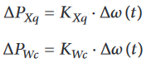
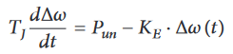
Cascade Failures in Electrical Communication Networks (ECN) [wang 2019]
interdependent fault propagation model
ECN= smart grid to monitor and control electrical networks
Virus infection propagates causing a failure cascades leading to energy blackouts.
SIR expressed in vertex degree
System frequency characteristics
Load Px and Generation Pw
Redistribute Power Unbalance
Dynamic Power Flow Algorithm
overloaded operational time at each branch Bj
source: Wang et al. (2019), Cascading Failures Analysis Considering Extreme Virus Propagation of Cyber-Physical Systems in Smart Grids
Notes:
Tau-1 infection cycle
Tau-2 removal cycle
Kx = Equivalent load frequency regulation
Kw = Equivalent generator unit power regulation
Delta Px = Changes in power of all loads
Delta Px = Changes in power of all generators
Delta Omega = Changes of angular acceleration of equivalent generator
Rotor equation allow to compute the
Delta Kxq = Changes of power of load q
Delta Kwc = Changes of power of generator c
Tj =Equivalent Inertia time constant
KE = system unit power regulation
Interactive Cascading Failure Model
Power flow redistribution employs
primary frequency regulation ‎[46, 47] and rotor equation ‎[48]
Two types of flow: communication and power
Two Time windows:
- virus infection cycle (SIR)
tripping time of overloaded branches
[Wang

Slide 20
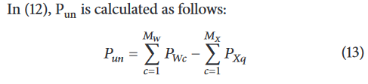
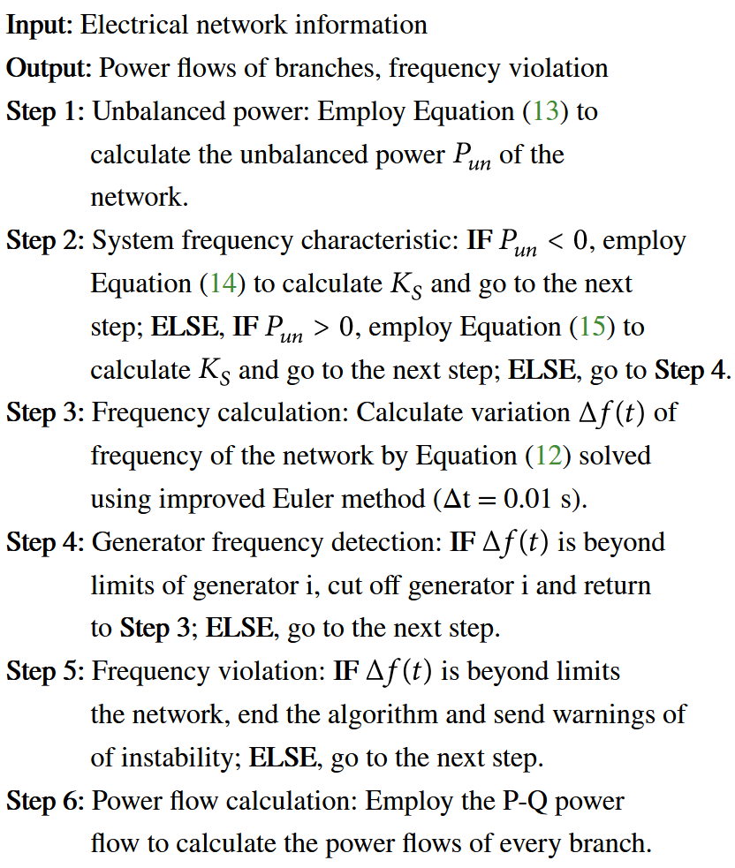
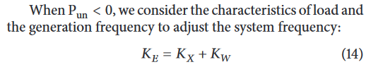
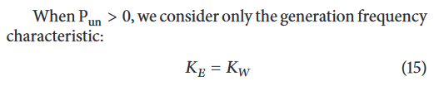
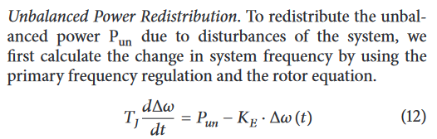
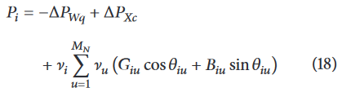
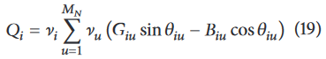
Dynamic Power Flow Algorithm
source: Wang et al. (2019)
Notes:
Wang et al. (2019), Cascading Failures Analysis Considering Extreme Virus Propagation of Cyber-Physical Systems in Smart Grids

Slide 21
Influence Maximization Models

Slide 22
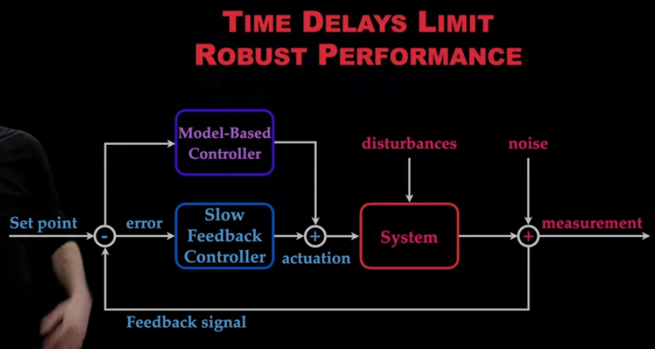
Robustness to Time Delays
Notes:
source: Steve Brunton, Control Theory and COVID-19: Models
https://www.youtube.com/watch?v=jmfsSmHAQ2o

Slide 24
Outbreak Detection Models

Slide 25
Final Presentations of GNN projects
05/Mar: Name Entity Disambiguation - Valdimar & Mai
17/Mar: Comment Predictions on Online News – Sassan
19/Mar: Protein Interactions – Henrik & Simon
24/Mar: Space-Time Graphs for Traffic Predictions – Max, Tiago & Tibor
26/Mar: Community Interaction Predictions – Bastian, Berkey & Leo
29/Mar: Key-phrase Classification - Maria
Last day to turn in the report March 29.

Slide 26
END

